Slide 1
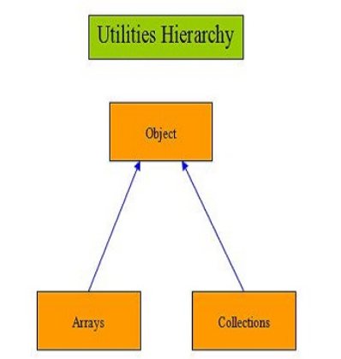

Slide 2
What is Collections ?
In Java, the Collections Framework is a hierarchy of interfaces and classes that provides an easy management of a group of objects.
or
It provides a ready-made architecture for interfaces and classes and used for storing and manipulating a group of objects.

Slide 3
“Collections” is a utility class of the Java Collection framework. It has static methods that allow performing operations on the objects of the type Collection. Some common methods in the Collection class are as follows.
Collections.max() – Helps to find the maximum value present in the collection
Collection.min() – Helps to find the maximum value present in the collection
Collection.sort() – Allows sorting the elements of the collection
Collection.copy() – Helps to copy elements of one collection into some other collection
Collection.reverse() – Allows reversing the order of the elements in the collection
Collections.binarySerach() – Helps to search an element using the binary search algorithm

Slide 4
Now you might be wondering what is its need. Collections in Java were not a part of the original Java release. But prior to the release, Vectors, Stacks and Arrays were there. They had one major disadvantage, and that was lesser similarities. They didn't have a common interface and interconnection with each other.
In this case, it becomes tedious for the user to remember all the functions and syntax. Plus, the conventional ways like arrays and stacks weren't providing the desired performance and flexibility.
This is why the Collections Framework and collection in Java was introduced in order to overcome the drawbacks mentioned above.

Slide 5
Eg-
Collections.reverse(myList);
Collections.rotate(myList, 4);

Slide 6
Arrays

Slide 7
The collections in java provide an architecture to store and manipulate the group of objects, interfaces and classes. A collection is a group of objects or it is a single entity that represents multiple objects.
In java to represent group of objects into a single entity we need certain number of classes and interfaces so collection framework will provide you those classes and interfaces,
So we can say that collection framework means it defines the different interfaces and classes by which we can represent group of objects into a collection.

Slide 8
How do Arrays in Java work?
As discussed above, an array is a data structure or container that stores the same typed elements in a sequential format.
Let's use the above example to know how arrays work in java. This is how we can implement a program to store five subject marks of a student:
int mark1 = 78;
int mark2 = 84;
int mark3 = 63;
int mark4 = 91;
int mark5 = 75;
But what if we store all these five variables in one single variable?
marks[0] = 78;
marks[1] = 84;
marks[2] = 63;
marks[3] = 91;
marks[4] = 75;

Slide 9
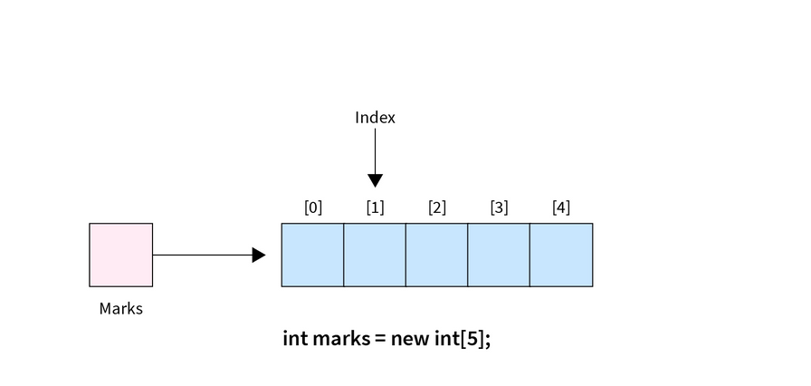

Slide 10
All above mentioned five variables could be accessed by the index given in the square bracket, which is known as index-based variables.
The index always starts from 0 by default. So, if we have an array of 5 elements, it will have an index range from 0 to 4 by default.
In the above example, the first element is stored at index 0 and the last one at the 4th index. The below-mentioned diagram shows how the array got placed in computer memory.

Slide 11
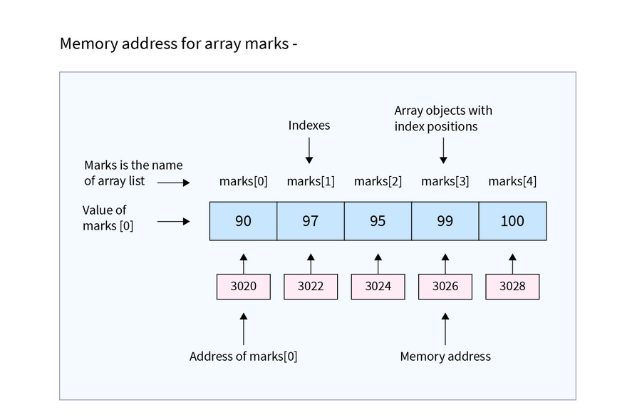

Slide 12
How to Create and Initialize Array in Java?
In every program, to use an array, we need to create it before it is used. We require two things to create an array in Java - data type and length.
As we know, an array is a homogenous container that can only store the same type of data. Hence, it's required to specify the data type while creating it. Moreover, we also need to put the number of elements the array will store.
Syntax:
Unlike other programming languages, while declaring an array in java, we can put [] both before and after the variable name.
The new keyword is crucial to creating an array. Without using it, we cannot make array reference variables.

Slide 13
Syntax-
datatype[] arrayName = new datatype[length];
OR
datatype arrayName[] = new datatype[length];

Slide 14
Example-
int[] myArray = new int[5];
int myArray1[] = new int[5];

Slide 15
We can Initialize Arrays in Java in two Different ways -
Initialize using index - Once an array is created successfully, we can assign the value to any specific element using its index. Un-assigned elements automatically take the default value of the array's data type. In this case, 0 for the integer data type. On the other hand, if we try to enter more values than the size of the array, it will raise an ArrayIndexOutOfBoundsException.
int[] myArray = new int[5]; // array declared
myArray[0] = 10; // assigned 10 at index 0
myArray[2] = 37; // assigned 37 at index 0
Array will be -
10 0 37 0 0

Slide 16
2. Initialize while declaring - We can also initialize the whole array while declaring it just by using curly brackets {}. The string must be in quotes, whereas int, float, etc., do not require that.
Eg-
int[] myArray = {1, 2, 3, 4, 5}; // For integer type
String[] myArray1 = {"A", "B", "C", "D"};

Slide 17
How to Change an Array Element?
To change a value at a specific position in Java arrays, refer to an index. By providing index value, we tell the Java compiler where we want to change the value.
For this, we need to use a Square bracket [] with an index number inside it. If somehow we entered the index number bigger than the array length, then an exception occurs of type ArrayIndexOutOfBoundsException (We will learn more about it in this article).

Slide 18
Eg-
public class Demo {
public static void main(String[] args) {
// declaring and initializing an array
int[] myArray = { 2, 3, 4, 5, 6 };
// print array element at index 0
System.out.println("Before change myArray[0]: " + myArray[0]);
// changing the array element
myArray[0] = 1;
// print array element at index 0
System.out.println("After change myArray[0]: " + myArray[0]);
}
}

Slide 19
Looping Through Array Elements
For performing any operation or displaying any elements, we used an index. But by using an index, we can only implement one operation at a time. If we are required to modify all elements in an array, we must write an operation for each index.
To overcome this situation, we have a looping feature in Java that follows the principle write once and execute multiple times.

Slide 20
There are two ways to loop through the array elements.
Using for Loop - In this way of looping through the array elements, we need the array's length first. This can be done by java in-built property length. If we start the for loop from 0, then the total iteration will be the array's length - 1, and if we start the for loop from 1, then the total iteration will be the length of an array.

Slide 21
eg-
public class Demo {
public static void main (String[] args) {
// declaring and initializing an array
String strArray[] = {"Python", "Java", "C++", "C", "PHP"};
// Find the length of an array
int lengthOfArray = strArray.length;
// using for loop
for(int i=0;i<lengthOfArray;i++) {
System.out.println(strArray[i]);
}
}
}

Slide 22
2. Using for-each loop - In this way, we use a for loop, but we do not need the length of the array. The for-each method is much easier to loop through the array element than looping for-loop. While using the for-each loop, we need to define a variable of the same type as the data type of the defined array. If not done, the compiler will throw compile time error saying- incompatible types: String cannot be converted to YourDefinedDataType.
public class Demo {
public static void main (String[] args) {
// declaring and initializing an array
String strArray[] = {"Python", "Java", "C++", "C", "PHP"};
// using for-each loop
for(String i : strArray) {
System.out.println(i);
}
}
}

Slide 23
Types of Array in Java
In Java, there are two types of arrays:
Single-Dimensional Array
Multi-Dimensional Array

Slide 24
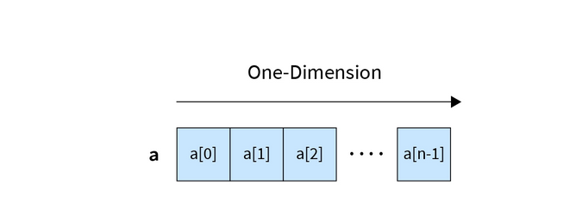
1. Single Dimensional Array
An array that has only one subscript or one dimension is known as a single-dimensional array. It is just a list of the same data type variables.

Slide 25
One dimensional array can be of either one row and multiple columns or multiple rows and one column. For instance, a student's marks in five subjects indicate a single-dimensional array. Example:
int marks[] = {56, 98, 77, 89, 99};
During the execution of the above line, JVM (Java Virtual Machine) will create five blocks at five different memory locations representing marks[0], marks[1], marks[2], marks[3], and marks[4].
Also be done using new keyword.

Slide 26
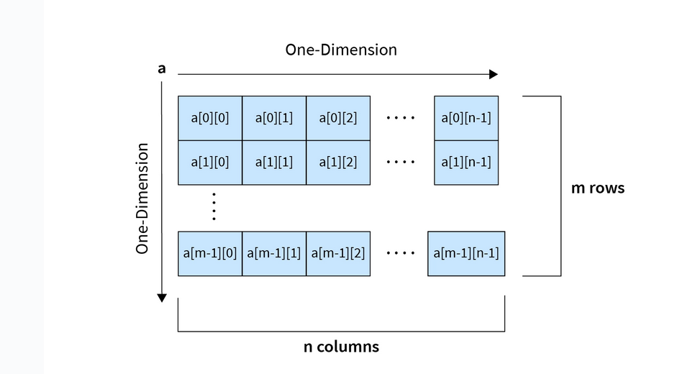
2. Multi-Dimensional Array
In not all cases, we implement a single-dimensional array. Sometimes, we are required to create an array within an array.

Slide 27
A multi-dimensional array is just an array of arrays that represents multiple rows and columns. These arrays include 2D, 3D, and nD types. 2D data like tables and matrices can be represented using this type of array.
To implement a multi-dimensional array, one needs to add two square brackets instead of one. Example:
int marks[][] = {
{77,85,68,99,87},{98,56,79,90,92},
{78,88,56,70,99}
};
OR
int marks[][] = new int[3][5];
// both will create a 2D array with 3 rows and 5 columns.

Slide 28
Eg- matrix addition
public class Demo {
public static void main (String[] args) {
// declaring and initializing arrays
int arr1[][] = {{1,2,3},{4,5,6},{7,8,9}};
int arr2[][] = {{2,2,2},{2,2,2},{2,2,2}};
// Printing Array1 in matrix format
System.out.println("Array1 -");
for(int i=0;i<3;i++) { // for-loop for number of rows
for(int j=0;j<3;j++) { // for-loop for number of columns
System.out.print(arr1[i][j] + " ");
}
System.out.println();
}
// Printing Array2 in matrix format
System.out.println("Array2 -");
for(int i=0;i<3;i++) { // for-loop for number of rows
for(int j=0;j<3;j++) { // for-loop for number of columns
System.out.print(arr2[i][j] + " ");
}
System.out.println();
}
// creating another array with the same dimensions to store the result
int arr3[][] = new int[3][3];
// Multiplying arr1 and arr2, storing results in arr3
System.out.println("Addition of Array1 and Array2 - ");
for(int i=0;i<arr1.length;i++) {
for(int j=0;j<arr2.length;j++) {
arr3[i][j] = arr1[i][j] +arr2[i][j];
}
System.out.print(arr3[i][j] + " ");
}
System.out.println();
}
}
}

Slide 29
Arrays of Objects
As the name suggests, an array of objects is nothing but a list of objects stored in the array. Notice that it does not store objects in an array but stores the reference variable of that object. The syntax will be the same as above.
Example:
Student studentObj[] = new Student[3];
After the above statement executes, it will create an array of objects of the Student class with a length of 3 studentObj references. For each object reference, we need to implement an object using new.

Slide 30
class Student {
Student(int id, String name) {
System.out.println("Student ID is "+ id + " and name is "+ name );
}
}
public class Test {
public static void main (String[] args) {
// declaring an array of Object
Student obj[] = new Student[3];
obj[0] = new Student(1,"Bharat");
obj[1] = new Student(5,"Vivaan");
obj[2] = new Student(6,"Smith");
}
}

Slide 31
Passing Arrays to Methods
we pass variables as a parameter and can also pass the array to methods. While passing, we do not require adding a square bracket with an array name, but we do require that in formal parameters.
Passing an array while calling methods is not required to mention the size of the array. If you do so, then it will throw the compile-time error.
Note that it is not required to use the same name of the array variable in the parameter of a function as the array name. We can use any name we want. But make sure to define the parameter variable with the same data type defined in an array in the main function, or else you will see a compilation error.

Slide 32
Eg-
public class Test {
// defined function to find max number from an array
public static int findMax(int[] arr) {
int max = arr[0];
for(int i=1;i<arr.length;i++) {
if(max<arr[i]) {
max = arr[i];
}
}
return max;
}
public static void main (String[] args) {
// declaring and initializing an array
int myArray[] = {45,33,98,65,76,43,99,23,68};
// call function by passing array in it
int maxNumber = findMax(myArray);
System.out.println("The max number of array is " + maxNumber);
}
}

Slide 33
Returning Arrays from Methods
Sometimes, we need to pass an array to a method to perform some operations and want that modified array as a return value of the function.
We already learned how we could pass arrays in methods. Let's now see how to send arrays back from the function using the return keyword.
Let's understand it more clearly with a small Java program.

Slide 34
public class Test {
// defined function to find max number from an array
public static int[] doMultiplication(int[] arr) {
for(int i=0;i<arr.length;i++) {
arr[i] = arr[i] * 2;
}
return arr;
}
public static void main (String[] args) {
// declaring and initializing an array
int myArray[] = {1,2,3,4,5};
// call function by passing array in it
int[] multiplyArr = doMultiplication(myArray);
// print array
System.out.println("Array multiply by 2 is - " );
for(int i : multiplyArr) {
System.out.print(i + " ");
}
}
}

Slide 35
Collection Framework

Slide 36
The collections in java provide an architecture to store and manipulate the group of objects, interfaces and classes. A collection is a group of objects or it is a single entity that represents multiple objects.
In java to represent group of objects into a single entity we need certain number of classes and interfaces so collection framework will provide you those classes and interfaces,
So we can say that collection framework means it defines the different interfaces and classes by which we can represent group of objects into a collection.

Slide 37
Group of Elements
Element 1
Element 2
Element 3
Collection is representing this group of elements

Slide 38
We need classes and interfaces to represent this collection.
Eg.-
Array arr=new Array[100];

Slide 39
What is a need for the Collection Framework?
Suppose, A variable is created to store data and a 10 value is assigned (Example, int a =10). Now the programmer wants to store another data of the same datatype. So, the programmer needs to create another variable and assign a new value (Example, int b= 20).
If the programmer wants to store 100 values then the disadvantage of this is the programmer has to create multiple variables with a unique name and it is very time-consuming also.
In this case array concept is introduced. Programmer declare an array with specific size and store elements.

Slide 40
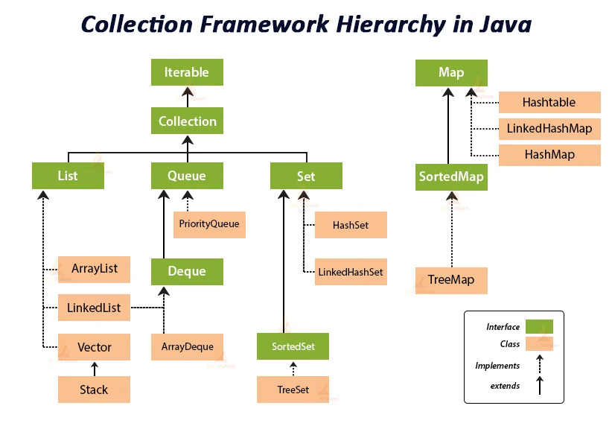

Slide 41
Iterable
It allows users to iterate through elements sequentially from a collection. It returns each element of the collection one after the other, beginning from the front, moving in a forward direction.
There are three ways in which elements can be iterated in Java, using enhanced for loop, forEach() method and by calling iterator() method. The Collection interface extends the Iterable interface thus, all the classes implementing the Collection interface are iterable.
Present inside java.lang.Iterable package.

Slide 42
Objects of Iterable can be Iterated in three ways:
Enhanced for loop(for-each loop)
Iterable forEach loop
Iterator<T> interface

Slide 43
Iterate an Iterable With the for-each Loop
The first way to iterate the elements of a Java Iterable is using Enhanced for loop. It is also known as for-each loop.
Objects of Classes implementing Collection Interface can be transversed using the for-each loop as Collection interface extends Iterable interface. Elements of the collection can only be read. They cannot be removed, updated, or added to the collection. Index of the element also cannot be accessed. We cannot skip any index or visit alternate positions.
Synttax:
for(DataType variable_name : CollectionName){
//action to be performed
}

Slide 44
Eg-
import java.io.*;
class Easy
{
public static void main(String[] args)
{
// array declaration
int ar[] = { 10, 50, 60, 80, 90 };
for (int element : ar)
System.out.print(element + " ");
}
}

Slide 45
Eg-
import java.util.*;
public class Main {
public static void main(String[] args) {
int[][] squares = new int[4][4];
for (int i = 0; i < 4; i++) {
for (int j = 0; j < 4; j++) {
squares[i][j] = (i + 1) * (j + 1);
}
}
System.out.println("Printing elements of a 2D array using for-each loop");
for (int[] rows : squares) {
for (int column : rows) {
System.out.print(column + " ");
}
System.out.println();
}
}
}

Slide 46
class IterateUsingEnhancedForLoop {
public static void main (String[] args) {
// create a list
List<String> list = new ArrayList<String>();
// add elements
list.add("Geeks");
list.add("for");
list.add("Geeks");
// Iterate through the list
for( String element : list ){
System.out.println( element );
}
}
}

Slide 47
Iterate an Iterable using forEach loop
The forEach() method takes the Lambda Expression as a parameter. This Lambda Expression is called for each element of the collection. In the below example, for each element of the list, the function prints the element to the console.

Slide 48
class IterateUsingforEach {
public static void main(String[] args)
{
// create a list
List<String> list = new ArrayList<>();
// add elements to the list
list.add("Welcome");
list.add("to the");
list.add("Class");
// Iterate through the list
list.forEach(
(element) -> { System.out.println(element); });
}
}

Slide 49
Iterate an Iterable via an Iterator
We can iterate the elements of Java Iterable by obtaining the Iterator from it using the iterator() method.
The methods used while traversing the collections using Iterator to perform the operations are:
hasNext(): It returns false if we have reached the end of the collection, otherwise returns true.
next(): Returns the next element in a collection.
remove(): Removes the last element returned by the iterator from the collection.
forEachRemaining(): Performs the given action for each remaining element in a collection, in sequential order.

Slide 50
class IterateUsingIterator {
public static void main(String[] args)
{
List<String> list = new ArrayList<>();
list.add("Welome");
list.add("to the");
list.add("Class");
Iterator<String> iterator = list.iterator();
while (iterator.hasNext()) {
String element = iterator.next();
System.out.println(element);
}
}
}

Slide 51
import java.util.*;
import java.lang.Iterable;
public class TempFile {
public static void main(String[] args) {
Stack<Integer> stack = new Stack<>();
for (int i = 0; i < 6; i++) {
stack.push(i * i);
}
// creating Iterator named iter
Iterator<Integer> iter;
iter = stack.iterator();
// iterating elements of the set
while (iter.hasNext()) {
int nextElement = iter.next();
System.out.print(nextElement + " ");
}
}
}

Slide 52
Java Collection Interface
The Collection interface is the root interface of the collections framework hierarchy.
Java does not provide direct implementations of the Collection interface but provides implementations of its subinterfaces like List, Set, and Queue.

Slide 53
Collections Framework Vs. Collection Interface
Collection | Collections
It is an interface. | It is a utility class.
It is utilized to represent a group of individual objects in the form of a single unit. | It specifies several utility methods that are used to work on the collection.
The Collection is an interface that includes a static method since the launch of Java8. The Interface can contain default and abstract methods. | It contains static methods only.
It extends the iterable interface. | It extends the Object class.

Slide 54
Need For Collection?
These Collection interfaces help us in dealing with various objects by grouping them efficiently and performing operations accordingly. These objects might be similar or different from each other. Based on the objects and their way of dealing with individual objects, we have the above-mentioned sub-interfaces.

Slide 55
List
The List interface in Java provides a way to store the ordered collection. It is a child interface of Collection. It is an ordered collection of objects in which duplicate values can be stored. Since List preserves the insertion order, it allows positional access and insertion of elements.
The List interface is found in java.util package and inherits the Collection interface. It is a factory of ListIterator interface. Through the ListIterator, we can iterate the list in forward and backward directions. The implementation classes of the List interface are ArrayList, LinkedList, Stack, and Vector. ArrayList and LinkedList are widely used in Java programming. The Vector class is deprecated since Java 5.

Slide 56
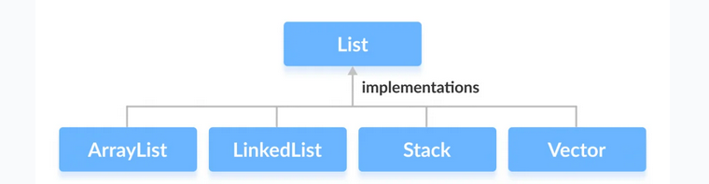

Slide 57
Methods of List
Some of the commonly used methods of the Collection interface that's also available in the List interface are:
add() - adds an element to a list
addAll() - adds all elements of one list to another
get() - helps to randomly access elements from lists
iterator() - returns iterator object that can be used to sequentially access elements of lists
set() - changes elements of lists
remove() - removes an element from the list
removeAll() - removes all the elements from the list
clear() - removes all the elements from the list (more efficient than removeAll())
size() - returns the length of lists
toArray() - converts a list into an array
contains() - returns true if a list contains specified element

Slide 58
Implementing arraylist class
import java.util.List;
import java.util.ArrayList;
class Main {
public static void main(String[] args) {
// Creating list using the ArrayList class
List<Integer> numbers = new ArrayList<>();
// Add elements to the list
numbers.add(1);
numbers.add(2);
numbers.add(3);
System.out.println("List: " + numbers);
// Access element from the list
int number = numbers.get(2);
System.out.println("Accessed Element: " + number);
// Remove element from the list
int removedNumber = numbers.remove(1);
System.out.println("Removed Element: " + removedNumber);
}
}

Slide 59
Class 1: ArrayList
An ArrayList class which is implemented in the collection framework provides us with dynamic arrays in Java. Though, it may be slower than standard arrays but can be helpful in programs where lots of manipulation in the array is needed.

Slide 60
Creating an ArrayList
ArrayList<Type> arrayList= new ArrayList<>();
List<Type> arrayList=new ArrayList<>();

Slide 61
The important points about the Java ArrayList class are:
Java ArrayList class can contain duplicate elements.
Java ArrayList class maintains insertion order.
Java ArrayList class is non synchronized.
Java ArrayList allows random access because the array works on an index basis.
In ArrayList, manipulation is a little bit slower than the LinkedList in Java because a lot of shifting needs to occur if any element is removed from the array list.
We can not create an array list of the primitive types, such as int, float, char, etc. It is required to use the required wrapper class in such cases.
Eg-
ArrayList<int> al = ArrayList<int>(); // does not work
ArrayList<Integer> al = new ArrayList<Integer>(); // works fine

Slide 62
Java Non-generic Vs. Generic Collection
Java collection framework was non-generic before JDK 1.5. Since 1.5, it is generic.
Java new generic collection allows you to have only one type of object in a collection. Now it is type-safe, so typecasting is not required at runtime.

Slide 63
Eg-
ArrayList list=new ArrayList();//creating old non-generic arraylist
Eg-
ArrayList<String> list=new ArrayList<String>();//creating new generic arraylist

Slide 64
Java ArrayList Vs Array
In Java, we need to declare the size of an array before we can use it. Once the size of an array is declared, it's hard to change it.
To handle this issue, we can use the ArrayList class. It allows us to create resizable arrays.
Unlike arrays, arraylists can automatically adjust their capacity when we add or remove elements from them. Hence, arraylists are also known as dynamic arrays.

Slide 65
// Java program to demonstrate the
// creation of list object using the
// ArrayList class
import java.io.*;
import java.util.*;
class Main {
public static void main(String[] args)
{
// Size of ArrayList
int n = 5;
// Declaring the List with initial size n
List<Integer> arrli
= new ArrayList<Integer>(n);
// Appending the new elements
// at the end of the list
for (int i = 1; i <= n; i++)
arrli.add(i);
// Printing elements
System.out.println(arrli);
// Remove element at index 3
arrli.remove(3);
// Displaying the list after deletion
System.out.println(arrli);
// Printing elements one by one
for (int i = 0; i < arrli.size(); i++)
System.out.print(arrli.get(i) + " ");
}
}

Slide 66
Commonly used functions are:
int indexOf(Object o)
boolean isEmpty()
boolean remove(Object obj)
boolean addAll(Collection c)
add(int index, Element e)
add(Element e)
int size()

Slide 67
import java.util.ArrayList;
import java.util.Collection;
public class ArrayListExample {
public static void main(String[] args) {
// Create an ArrayList with 5 values
ArrayList<Integer> arrayList = new ArrayList<>();
arrayList.add(10);
arrayList.add(20);
arrayList.add(30);
arrayList.add(40);
arrayList.add(50);
// indexOf(Object o) - Find the index of an element in the ArrayList
int index = arrayList.indexOf(30);
System.out.println("Index of 30: " + index);
// isEmpty() - Check if the ArrayList is empty
boolean isEmpty = arrayList.isEmpty();
System.out.println("Is ArrayList empty? " + isEmpty);
// remove(Object obj) - Remove an element from the ArrayList
boolean removed = arrayList.remove(Integer.valueOf(40));
System.out.println("Removed 40? " + removed);
// addAll(Collection c) - Add all elements from a collection to the ArrayList
ArrayList<Integer> collection = new ArrayList<>();
collection.add(60);
collection.add(70);
collection.add(80);
boolean addedAll = arrayList.addAll(collection);
System.out.println("Added all? " + addedAll);
// add(int index, Element e) - Add an element at a specific index in the ArrayList
arrayList.add(2, 25);
System.out.println("ArrayList after adding 25 at index 2: " + arrayList);
// add(Element e) - Add an element to the end of the ArrayList
arrayList.add(90);
System.out.println("ArrayList after adding 90: " + arrayList);
// size() - Get the size of the ArrayList
int size = arrayList.size();
System.out.println("Size of ArrayList: " + size);
for (int i = 0; i < arrli.size(); i++)
System.out.print(arrli.get(i) + " ");
}
}

Slide 68
Class 2: Vector
Vector is a class that is implemented in the collection framework implements a growable array of objects. Vector implements a dynamic array that means it can grow or shrink as required. Like an array, it contains components that can be accessed using an integer index. Vectors basically fall in legacy classes but now it is fully compatible with collections. Let’s see how to create a list object using this class.
It can use iterable or enumeration interface to iterate the elements.

Slide 69
Creating a Vector
// create Integer type linked list
Vector<Integer> vector= new Vector<>();
// create String type linked list
Vector<String> vector= new Vector<>();

Slide 70
Add Elements to Vector
add(element) - adds an element to vectors
add(index, element) - adds an element to the specified position
addAll(vector) - adds all elements of a vector to another vector
Access Vector Elements
get(index) - returns an element specified by the index
iterator() - returns an iterator object to sequentially access vector elements

Slide 71
Remove Vector Elements
remove(index) - removes an element from specified position
removeAll() - removes all the elements
clear() - removes all elements. It is more efficient than removeAll()

Slide 72
Some other functions:
set()
changes an element of the vector
size()
returns the size of the vector
toArray()
converts the vector into an array
toString()
converts the vector into a String
contains()
searches the vector for specified element and returns a boolean result

Slide 73
// Java program to demonstrate the
// creation of list object using the
// Vector class
import java.io.*;
import java.util.*;
class Main {
public static void main(String[] args)
{
// Size of the vector
int n = 5;
// Declaring the List with initial size n
Enumeration months;
List<Integer> v = new Vector<Integer>(n);
// Appending the new elements
// at the end of the list
for (int i = 1; i <= n; i++)
v.add(i);
// Printing elements
System.out.println(v);
// Remove element at index 3
v.remove(3);
// Displaying the list after deletion
System.out.println(v);
// Printing elements one by one
for (int i = 0; i < v.size(); i++)
System.out.print(v.get(i) + " ");
//enumerated way
months = v.elements();
while (months.hasMoreElements()) {
System.out.println(months.nextElement());
}
}
}

Slide 74
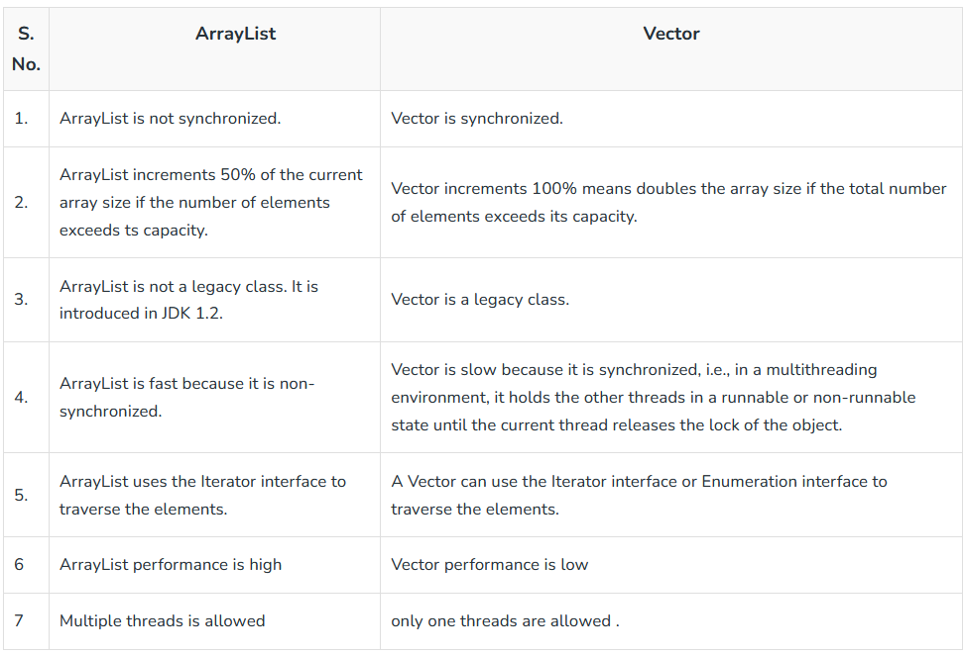

Slide 75
Class 3: Stack
Stack is a class that is implemented in the collection framework and extends the vector class models and implements the Stack data structure. The class is based on the basic principle of last-in-first-out. In addition to the basic push and pop operations, the class provides three more functions of empty, search and peek.
Stack is a linear data structure that follows a particular order in which the operations are performed. The order may be LIFO(Last In First Out) or FILO(First In Last Out). LIFO implies that the element that is inserted last, comes out first and FILO implies that the element that is inserted first, comes out last.

Slide 76
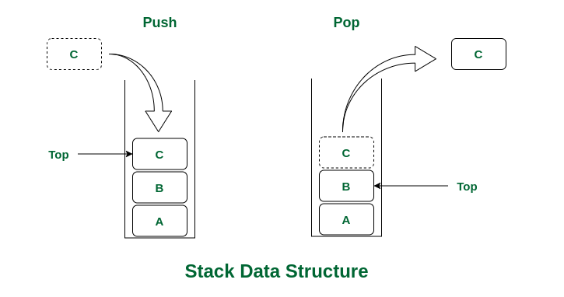

Slide 77
Creating a Stack
// Create Integer type stack
Stack<Integer> stacks = new Stack<>();
// Create String type stack
Stack<String> stacks = new Stack<>();

Slide 78
Stack Methods
push() Method
To add an element to the top of the stack, we use the push() method.
pop() Method
To remove an element from the top of the stack, we use the pop() method.
peek() Method
The peek() method returns an object from the top of the stack.
empty() Method
To check whether a stack is empty or not, we use the empty() method.

Slide 79
// Java code for stack implementation
import java.io.*;
import java.util.*;
class Test
{
// Pushing element on the top of the stack
static void stack_push(Stack<Integer> stack)
{
for(int i = 0; i < 5; i++)
{
stack.push(i);
}
}
// Popping element from the top of the stack
static void stack_pop(Stack<Integer> stack)
{
System.out.println("Pop Operation:");
for(int i = 0; i < 5; i++)
{
Integer y = (Integer) stack.pop();
System.out.println(y);
}
}
// Displaying element on the top of the stack
static void stack_peek(Stack<Integer> stack)
{
Integer element = (Integer) stack.peek();
System.out.println("Element on stack top: " + element);
}
// Searching element in the stack
static void stack_search(Stack<Integer> stack, int element)
{
Integer pos = (Integer) stack.search(element);
if(pos == -1)
System.out.println("Element not found");
else
System.out.println("Element is found at position: " + pos);
}
public static void main (String[] args)
{
Stack<Integer> stack = new Stack<Integer>();
stack_push(stack);
stack_pop(stack);
stack_push(stack);
stack_peek(stack);
stack_search(stack, 2);
stack_search(stack, 6);
}
}

Slide 80
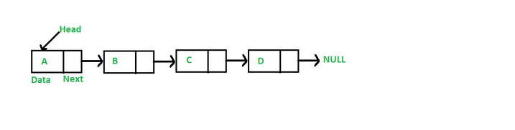
Class 4: LinkedList
LinkedList is a class that is implemented in the collection framework which inherently implements the linked list data structure. It is a linear data structure where the elements are not stored in contiguous locations and every element is a separate object with a data part and address part. The elements are linked using pointers and addresses. Each element is known as a node. Due to the dynamicity and ease of insertions and deletions, they are preferred over the arrays.

Slide 81
List of operations we can perform:
Adding elements add(),add(index,value)
Updating elements set(index,value)
Removing elements remove(),remove(index)
Iterating over elements get(index)
To Array();
Eg-
Object[] a = list.toArray();
System.out.print("After converted LinkedList to Array: ");
for(Object element : a)
System.out.print(element+" ");
Size(); size()
remove First() removeFirst();
remove last(); removeLast();
Add last; addLast(value);

Slide 82
// Java Program to Demonstrate
// Implementation of LinkedList
// class
// Importing required classes
import java.util.*;
// Main class
public class Main {
// Driver code
public static void main(String args[])
{
// Creating object of the
// class linked list
LinkedList<String> ll = new LinkedList<String>();
// Adding elements to the linked list
ll.add("A");
ll.add("B");
ll.addLast("C");
ll.addFirst("D");
ll.add(2, "E");
System.out.println(ll);
ll.remove("B");
ll.remove(3);
ll.removeFirst();
ll.removeLast();
System.out.println(ll);
}
}

Slide 83
Advantages of using LinkedList in Java:
Dynamic size: As with Vector, the size of a LinkedList can grow or shrink dynamically, so you don’t have to worry about setting an initial size.
Efficient Insertions and Deletions: LinkedList is an efficient data structure for inserting or deleting elements in the middle of the list because you only need to change the links between elements, rather than shifting all elements after the insertion or deletion point.
Flexible Iteration: With a linked list, you can efficiently iterate through the list in either direction, since each element has a reference to both its predecessor and successor elements.

Slide 84
Disadvantages of using LinkedList in Java:
Performance: LinkedList has a slower performance than ArrayList when it comes to accessing individual elements. This is because you need to traverse the list to reach the desired element, whereas with ArrayList, you can simply access the desired element using an index.
Memory overhead: LinkedList requires more memory than ArrayList because each element requires additional memory for the links to its predecessor and successor elements.

Slide 85
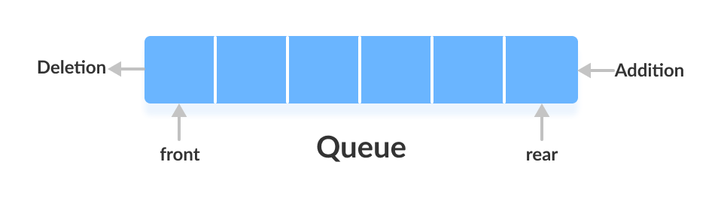
Queue Interface

Slide 86
A Queue is like a line waiting to purchase tickets, where the first person in line is the first person served. (i.e. First come first serve).
Position of the entry in a queue ready to be served, that is, the first entry that will be removed from the queue, is called the front of the queue(sometimes, head of the queue), similarly, the position of the last entry in the queue, that is, the one most recently added, is called the rear (or the tail) of the queue.

Slide 87
Characteristics of Queue:
Queue can handle multiple data.
We can access both ends.
They are fast and flexible.

Slide 88
The Queue interface of the Java collections framework provides the functionality of the queue data structure. It extends the Collection interface.
It is an ordered list of objects with its use limited to inserting elements at the end of the list and deleting elements from the start of the list, (i.e.), it follows the FIFO or the First-In-First-Out principle.

Slide 89
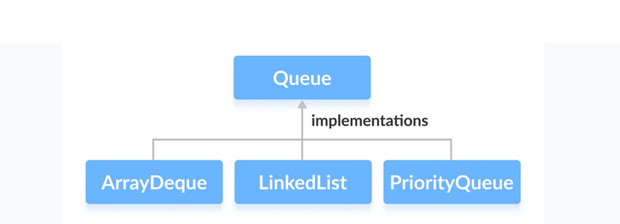

Slide 90
How to use Queue?
In Java, we must import java.util.Queue package in order to use Queue.
// LinkedList implementation of Queue
Queue<String> animal1 = new LinkedList<>();
// Array implementation of Queue
Queue<String> animal2 = new ArrayDeque<>();
// Priority Queue implementation of Queue
Queue<String> animal 3 = new PriorityQueue<>();

Slide 91
Methods of Queue
The Queue interface includes all the methods of the Collection interface. It is because Collection is the super interface of Queue.
Some of the commonly used methods of the Queue interface are:
add() - Inserts the specified element into the queue. If the task is successful, add() returns true, if not it throws an exception.
offer() - Inserts the specified element into the queue. If the task is successful, offer() returns true, if not it returns false.
element() - Returns the head of the queue. Throws an exception if the queue is empty.
peek() - Returns the head of the queue. Returns null if the queue is empty.
remove() - Returns and removes the head of the queue. Throws an exception if the queue is empty.
poll() - Returns and removes the head of the queue. Returns null if the queue is empty.

Slide 92
1. Implementing the LinkedList Class
import java.util.Queue;
import java.util.LinkedList;
class Main {
public static void main(String[] args) {
// Creating Queue using the LinkedList class
Queue<Integer> numbers = new LinkedList<>();
// offer elements to the Queue
numbers.offer(1);
numbers.offer(2);
numbers.offer(3);
System.out.println("Queue: " + numbers);
// Access elements of the Queue
int accessedNumber = numbers.peek();
System.out.println("Accessed Element: " + accessedNumber);
// Remove elements from the Queue
int removedNumber = numbers.poll();
System.out.println("Removed Element: " + removedNumber);
System.out.println("Updated Queue: " + numbers);
}
}

Slide 93
2. Implementing the PriorityQueue Class
import java.util.Queue;
import java.util.PriorityQueue;
class Main {
public static void main(String[] args) {
// Creating Queue using the PriorityQueue class
Queue<Integer> numbers = new PriorityQueue<>();
// offer elements to the Queue
numbers.offer(5);
numbers.offer(1);
numbers.offer(2);
System.out.println("Queue: " + numbers);
// Access elements of the Queue
int accessedNumber = numbers.peek();
System.out.println("Accessed Element: " + accessedNumber);
// Remove elements from the Queue
int removedNumber = numbers.poll();
System.out.println("Removed Element: " + removedNumber);
System.out.println("Updated Queue: " + numbers);
}
}

Slide 94
PriorityQueue
The PriorityQueue class provides the functionality of the heap data structure.
By default it is min heap.
Why?
Min heaps are widely used to retrieve the smallest element in a pool of elements in constant time.
It is important to note that the elements of a priority queue may not be sorted. However, elements are always retrieved in sorted order.

Slide 95
Creating PriorityQueue
In order to create a priority queue, we must import the java.util.PriorityQueue package. Once we import the package, here is how we can create a priority queue in Java.
PriorityQueue<Integer> numbers = new PriorityQueue<>();
Here, we have created a priority queue without any arguments. In this case, the head of the priority queue is the smallest element of the queue. And elements are removed in ascending order from the queue.

Slide 96
Methods of PriorityQueue
-Insert Elements to PriorityQueue
add() - Inserts the specified element to the queue. If the queue is full, it throws an exception.
offer() - Inserts the specified element to the queue. If the queue is full, it returns false.
-Access PriorityQueue Elements
peek()-To access elements from a priority queue
-Remove PriorityQueue Elements
remove() - removes the specified element from the queue
poll() - returns and removes the head of the queue

Slide 97
import java.util.PriorityQueue;
public class PriorityQueueExample {
public static void main(String[] args) {
// Create a priority queue with initial capacity 10
PriorityQueue<Integer> pq = new PriorityQueue<>(10);
// Add elements to the queue
pq.add(3);
pq.add(1);
pq.add(2);
pq.add(5);
pq.add(4);
// Print the queue
System.out.println("Priority queue: " + pq);
// Peek at the top element of the queue
System.out.println("Peek: " + pq.peek());
// Remove the top element of the queue
pq.poll();
// Print the queue again
System.out.println("Priority queue after removing top element: " + pq);
// Check if the queue contains a specific element
System.out.println("Does the queue contain 3? " + pq.contains(3));
// Get the size of the queue
System.out.println("Size of queue: " + pq.size());
// Remove all elements from the queue
pq.clear();
// Check if the queue is empty
System.out.println("Is the queue empty? " + pq.isEmpty());
}
}

Slide 98
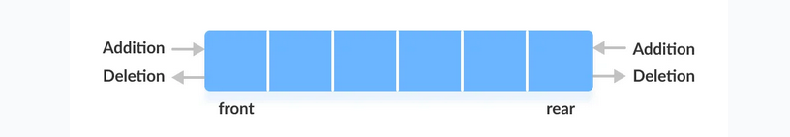
Deque Interface
The Deque interface of the Java collections framework provides the functionality of a double-ended queue. It extends the Queue interface.
Working of Deque
In a regular queue, elements are added from the rear and removed from the front. However, in a deque, we can insert and remove elements from both front and rear.

Slide 99
Methods of Deque
Since Deque extends the Queue interface, it inherits all the methods of the Queue interface.
Besides methods available in the Queue interface, the Deque interface also includes the following methods:
addFirst() - Adds the specified element at the beginning of the deque. Throws an exception if the deque is full.
addLast() - Adds the specified element at the end of the deque. Throws an exception if the deque is full.
offerFirst() - Adds the specified element at the beginning of the deque. Returns false if the deque is full.
offerLast() - Adds the specified element at the end of the deque. Returns false if the deque is full.
getFirst() - Returns the first element of the deque. Throws an exception if the deque is empty.
getLast() - Returns the last element of the deque. Throws an exception if the deque is empty.
peekFirst() - Returns the first element of the deque. Returns null if the deque is empty.
peekLast() - Returns the last element of the deque. Returns null if the deque is empty.
removeFirst() - Returns and removes the first element of the deque. Throws an exception if the deque is empty.
removeLast() - Returns and removes the last element of the deque. Throws an exception if the deque is empty.
pollFirst() - Returns and removes the first element of the deque. Returns null if the deque is empty.
pollLast() - Returns and removes the last element of the deque. Returns null if the deque is empty.

Slide 100
ArrayDeque
In Java, we can use the ArrayDeque class to implement queue and deque data structures using arrays.

Slide 101
// Java program to Implement ArrayDeque in Java
//
// Importing utility classes
import java.util.*;
// ArrayDequeDemo
public class Main {
public static void main(String[] args)
{
// Creating and initializing deque
// Declaring object of integer type
Deque<Integer> de_que = new ArrayDeque<Integer>(10);
// Operations 1
// add() method
// Adding custom elements
// using add() method to insert
de_que.add(10);
de_que.add(20);
de_que.add(30);
de_que.add(40);
de_que.add(50);
// Iterating using for each loop
for (Integer element : de_que) {
// Print the corresponding element
System.out.println("Element : " + element);
}
// Operation 2
// clear() method
System.out.println("Using clear() ");
// Clearing all elements using clear() method
de_que.clear();
// Operations 3
// addFirst() method
// Inserting at the start
de_que.addFirst(564);
de_que.addFirst(291);
// Operation 4
// addLast() method
// Inserting at end
de_que.addLast(24);
de_que.addLast(14);
// Display message
System.out.println(
"Above elements are removed now");
// Iterators
// Display message
System.out.println(
"Elements of deque using Iterator :");
for (Iterator itr = de_que.iterator();
itr.hasNext();) {
System.out.println(itr.next());
}
// descendingIterator()
// To reverse the deque order
System.out.println(
"Elements of deque in reverse order :");
for (Iterator dItr = de_que.descendingIterator();
dItr.hasNext();) {
System.out.println(dItr.next());
}
// Operation 5
// element() method : to get Head element
System.out.println(
"\nHead Element using element(): "
+ de_que.element());
// Operation 6
// getFirst() method : to get Head element
System.out.println("Head Element using getFirst(): "
+ de_que.getFirst());
// Operation 7
// getLast() method : to get last element
System.out.println("Last Element using getLast(): "
+ de_que.getLast());
// Operation 8
// toArray() method :
Object[] arr = de_que.toArray();
System.out.println("\nArray Size : " + arr.length);
System.out.print("Array elements : ");
for (int i = 0; i < arr.length; i++)
System.out.print(" " + arr[i]);
// Operation 9
// peek() method : to get head
System.out.println("\nHead element : "
+ de_que.peek());
// Operation 10
// poll() method : to get head
System.out.println("Head element poll : "
+ de_que.poll());
// Operation 11
// push() method
de_que.push(265);
de_que.push(984);
de_que.push(2365);
// Operation 12
// remove() method : to get head
System.out.println("Head element remove : "
+ de_que.remove());
System.out.println("The final array is: " + de_que);
}
}

Slide 102
Set
The set interface is present in java.util package and extends the Collection interface. It is an unordered collection of objects in which duplicate values cannot be stored. It is an interface that implements the mathematical set. This interface contains the methods inherited from the Collection interface and adds a feature that restricts the insertion of the duplicate elements.

Slide 103
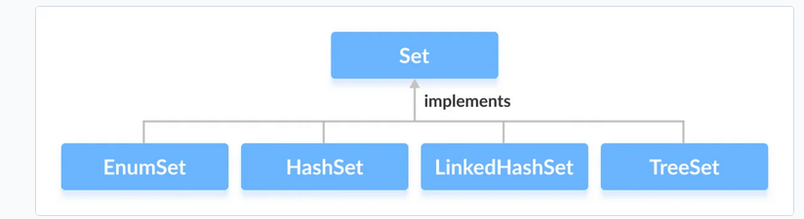

Slide 104
How to use Set?
Set<String> animals = new HashSet<>();

Slide 105
Methods of Set
The Set interface includes all the methods of the Collection interface. It's because Collection is a super interface of Set.
Some of the commonly used methods of the Collection interface that's also available in the Set interface are:
add() - adds the specified element to the set
addAll() - adds all the elements of the specified collection to the set
iterator() - returns an iterator that can be used to access elements of the set sequentially
remove() - removes the specified element from the set
removeAll() - removes all the elements from the set that is present in another specified set
retainAll() - retains all the elements in the set that are also present in another specified set
clear() - removes all the elements from the set
size() - returns the length (number of elements) of the set
toArray() - returns an array containing all the elements of the set
contains() - returns true if the set contains the specified element
containsAll() - returns true if the set contains all the elements of the specified collection
hashCode() - returns a hash code value (address of the element in the set)

Slide 106
Set Operations
The Java Set interface allows us to perform basic mathematical set operations like union, intersection, and subset.
Union - to get the union of two sets x and y, we can use x.addAll(y)
Intersection - to get the intersection of two sets x and y, we can use x.retainAll(y)
Subset - to check if x is a subset of y, we can use y.containsAll(x)

Slide 107
1. Implementing HashSet Class
import java.util.Set;
import java.util.HashSet;
class Main {
public static void main(String[] args) {
// Creating a set using the HashSet class
Set<Integer> set1 = new HashSet<>();
// Add elements to the set1
set1.add(2);
set1.add(3);
System.out.println("Set1: " + set1);
// Creating another set using the HashSet class
Set<Integer> set2 = new HashSet<>();
// Add elements
set2.add(1);
set2.add(2);
System.out.println("Set2: " + set2);
// Union of two sets
set2.addAll(set1);
System.out.println("Union is: " + set2);
}
}

Slide 108
2. Implementing TreeSet Class
import java.util.Set;
import java.util.TreeSet;
import java.util.Iterator;
class Main {
public static void main(String[] args) {
// Creating a set using the TreeSet class
Set<Integer> numbers = new TreeSet<>();
// Add elements to the set
numbers.add(2);
numbers.add(3);
numbers.add(1);
System.out.println("Set using TreeSet: " + numbers);
// Access Elements using iterator()
System.out.print("Accessing elements using iterator(): ");
Iterator<Integer> iterate = numbers.iterator();
while(iterate.hasNext()) {
System.out.print(iterate.next());
System.out.print(", ");
}
}
}

Slide 109
Java HashSet Class
The HashSet class of the Java Collections framework provides the functionalities of the hash table data structure.

Slide 110
The important points about Java HashSet class are:
HashSet stores the elements by using a mechanism called hashing.
HashSet contains unique elements only.
HashSet allows null value.
HashSet class is non synchronized.
HashSet doesn't maintain the insertion order. Here, elements are inserted on the basis of their hashcode.
HashSet is the best approach for search operations.
The initial default capacity of HashSet is 16, and the load factor is 0.75.

Slide 111
Insert Elements
add() - inserts the specified element to the set
addAll() - inserts all the elements of the specified collection to the set
Remove Elements
remove() - removes the specified element from the set
removeAll() - removes all the elements from the set

Slide 112
public class Main {
public static void main(String[] args) {
HashSet<String> cars = new HashSet<String>();
cars.add("Volvo");
cars.add("BMW");
cars.add("Ford");
cars.add("BMW");
cars.add("Mazda");
System.out.println(cars);
}
}

Slide 113
LinkedHashSet
The LinkedHashSet is an ordered version of HashSet that maintains a doubly-linked List across all elements. When the iteration order is needed to be maintained this class is used. When iterating through a HashSet the order is unpredictable, while a LinkedHashSet lets us iterate through the elements in the order in which they were inserted. When cycling through LinkedHashSet using an iterator, the elements will be returned in the order in which they were inserted.

Slide 114
// Java Program to Illustrate LinkedHashSet
// Importing required classes
import java.util.LinkedHashSet;
// Main class
// LinkedHashSetExample
public class Main{
// Main driver method
public static void main(String[] args)
{
// Creating an empty LinkedHashSet of string type
LinkedHashSet<String> linkedset
= new LinkedHashSet<String>();
// Adding element to LinkedHashSet
// using add() method
linkedset.add("A");
linkedset.add("B");
linkedset.add("C");
linkedset.add("D");
// Note: This will not add new element
// as A already exists
linkedset.add("A");
linkedset.add("E");
// Getting size of LinkedHashSet
// using size() method
System.out.println("Size of LinkedHashSet = "
+ linkedset.size());
System.out.println("Original LinkedHashSet:"
+ linkedset);
// Removing existing entry from above Set
// using remove() method
System.out.println("Removing D from LinkedHashSet: "
+ linkedset.remove("D"));
// Removing existing entry from above Set
// that does not exist in Set
System.out.println(
"Trying to Remove Z which is not "
+ "present: " + linkedset.remove("Z"));
// Checking for element whether it is present inside
// Set or not using contains() method
System.out.println("Checking if A is present="
+ linkedset.contains("A"));
// Noew lastly printing the updated LinkedHashMap
System.out.println("Updated LinkedHashSet: "
+ linkedset);
}
}

Slide 115
TreeSet
TreeSet is basically an implementation of a self-balancing binary search tree like a Red-Black Tree. Therefore operations like add, remove, and search takes O(log(N)) time. The reason is that in a self-balancing tree, it is made sure that the height of the tree is always O(log(N)) for all the operations. Therefore, this is considered as one of the most efficient data structures in order to store the huge sorted data and perform operations on it. However, operations like printing N elements in the sorted order take O(N) time.

Slide 116
// Java code to Illustrate Addition of Elements to TreeSet
// Importing utility classes
import java.util.*;
// Main class
class {
// Main driver method
public static void main(String[] args)
{
// Creating a Set interface with
// reference to TreeSet class
// Declaring object of string type
Set<String> ts = new TreeSet<>();
// Elements are added using add() method
ts.add("This");
ts.add("is");
ts.add("Getting");
ts.add("Better");
// Print all elements inside object
System.out.println(ts);
}
}

Slide 117
Accessing the Elements
After adding the elements, if we wish to access the elements, we can use inbuilt methods like contains(), first(), last(), etc.
Removing the Values
The values can be removed from the TreeSet using the remove() method. There are various other methods that are used to remove the first value or the last value.

Slide 118
TreeSet implements the SortedSet interface. So, duplicate values are not allowed.
Objects in a TreeSet are stored in a sorted and ascending order.
TreeSet does not preserve the insertion order of elements but elements are sorted by keys.
If we are depending on the default natural sorting order, the objects that are being inserted into the tree should be homogeneous and comparable. TreeSet does not allow the insertion of heterogeneous objects. It will throw a classCastException at Runtime if we try to add heterogeneous objects.

Slide 119
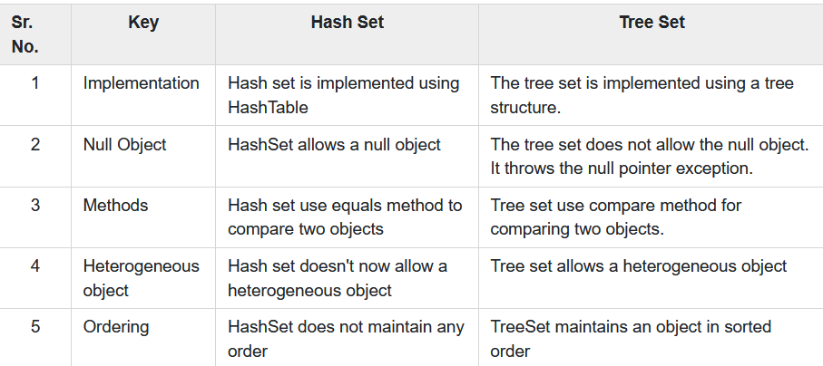

Slide 120
Why Map does not extend Collection interface?
Because they are of an incompatible type. List, Set and Queue are a collection of similar kind of objects but just values where a Map is a collection of key and value pairs.
List Set and Queue have add as a function which takes a value as param to add an element whereas Map has put as a function which takes a key and a value as params to add a key-value pair.
List, Set and Queue provide iterate functionality over the value whereas Maps has keys to iterate over which is ultimately a Set and Values as Collection.

Slide 121
Map Interface
A map contains values on the basis of key, i.e. key and value pair. Each key and value pair is known as an entry. A Map contains unique keys.
A Map is useful if you have to search, update or delete elements on the basis of a key.
Map<K,V> m=HashMap<K, V>();
This class is found in java.util package.

Slide 122
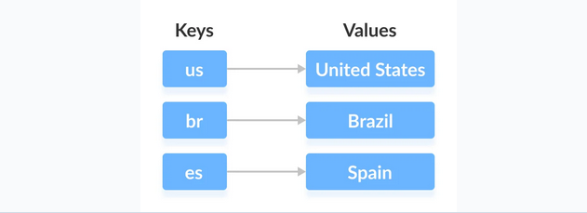
Working of Map
In Java, elements of Map are stored in key/value pairs. Keys are unique values associated with individual Values.
A map cannot contain duplicate keys. And, each key is associated with a single value.

Slide 123
We can access and modify values using the keys associated with them.
In the above diagram, we have values: United States, Brazil, and Spain. And we have corresponding keys: us, br, and es.
Now, we can access those values using their corresponding keys.
Note: The Map interface maintains 3 different sets:
the set of keys
the set of values
the set of key/value associations (mapping).
Hence we can access keys, values, and associations individually.

Slide 124
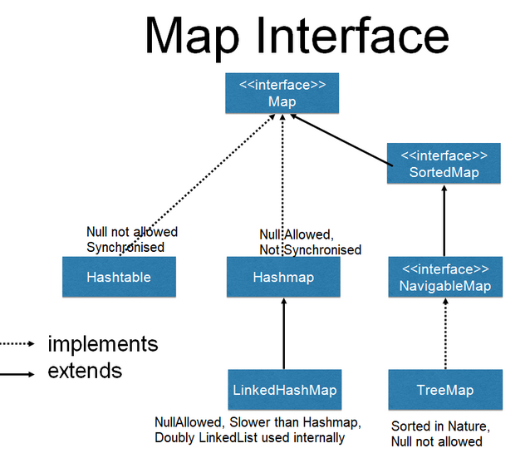

Slide 125
Hashtable
The Hashtable class implements a hash table, which maps keys to values. Any non-null object can be used as a key or as a value. To successfully store and retrieve objects from a hashtable, the objects used as keys must implement the hashCode method and the equals method.
However, the Hashtable class has since been considered obsolete and its use is generally discouraged. This is because it was designed prior to the introduction of the Collections framework and does not implement the Map interface, which makes it difficult to use in conjunction with other parts of the framework. In addition, the Hashtable class is synchronized, which can result in slower performance compared to other implementations of the Map interface.

Slide 126
Hashing (Hash Function)
In a hash table, a new index is processed using the keys. And, the element corresponding to that key is stored in the index. This process is called hashing.
Let k be a key and hahs(x) be a hash function.
Here, hahs(key) will give us a new index to store the element linked with k.

Slide 127
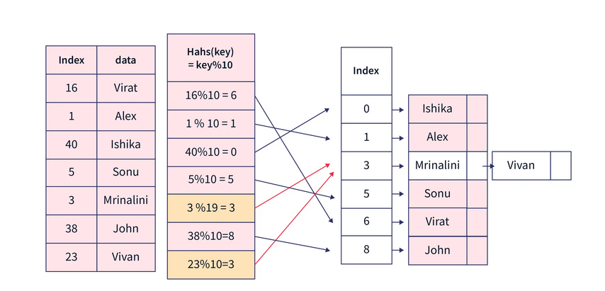

Slide 128
Hash Collision
When the hash function generates the same index for multiple keys, there will be a conflict (what value to be stored in that index). This is called a hash collision.
We can resolve the hash collision using one of the following techniques.
Collision resolution by chaining
Open Addressing: Linear/Quadratic Probing and Double Hashing

Slide 129
import java.util.Enumeration;
import java.util.Hashtable;
public class Main {
public static void main(String[] args) {
Hashtable<String, Integer> hashtable = new Hashtable<>();
// Adding elements to the hashtable
hashtable.put("A", 1);
hashtable.put("B", 2);
hashtable.put("C", 3);
// Getting values from the hashtable
int valueA = hashtable.get("A");
System.out.println("Value of A: " + valueA);
// Removing elements from the hashtable
hashtable.remove("B");
// Enumerating the elements of the hashtable
Enumeration<String> keys = hashtable.keys();
while (keys.hasMoreElements()) {
String key = keys.nextElement();
System.out.println("Key: " + key + ", Value: " + hashtable.get(key));
}
}
}

Slide 130
Features of Hashtable
It is similar to HashMap, but is synchronized.
Hashtable stores key/value pair in hash table.
In Hashtable we specify an object that is used as a key, and the value we want to associate to that key. The key is then hashed, and the resulting hash code is used as the index at which the value is stored within the table.
The initial default capacity of Hashtable class is 16 whereas loadFactor is 0.75.
HashMap doesn’t provide any Enumeration, while Hashtable provides not fail-fast Enumeration.

Slide 131
For HashMap DEFAULT_INITIAL_CAPACITY = 16 and DEFAULT_LOAD_FACTOR = 0.75f it means that MAX number of ALL Entries in the HashMap = 16 * 0.75 = 12. When the thirteenth element will be added capacity (array size) of HashMap will be doubled!

Slide 132
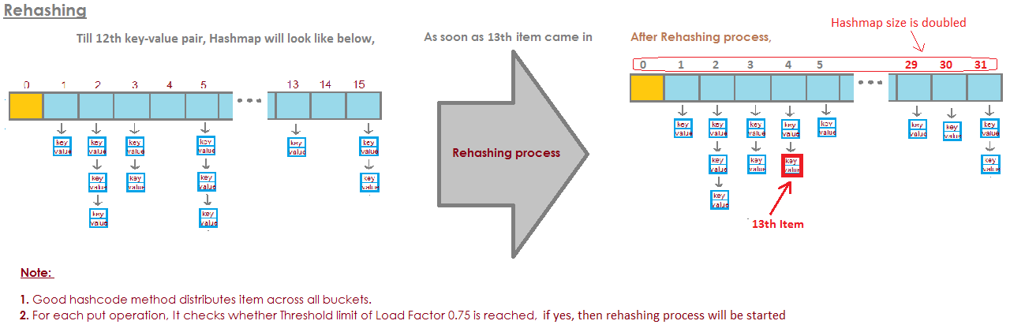

Slide 133
HashMap
It provides the basic implementation of the Map interface of Java. It stores the data in (Key, Value) pairs, and you can access them by an index of another type (e.g. an Integer). One object is used as a key (index) to another object (value). If you try to insert the duplicate key, it will replace the element of the corresponding key.
HashMap is similar to HashTable, but it is unsynchronized. It allows to store the null keys as well, but there should be only one null key object and there can be any number of null values.

Slide 134
Some of the key characteristics of a hashmap include:
Fast access time: HashMaps provide constant time access to elements, which means that retrieval and insertion of elements is very fast, usually O(1) time complexity.
Uses hashing function: HashMaps use a hash function to map keys to indices in an array. This allows for quick lookup of values based on keys.
Stores key-value pairs: Each element in a HashMap consists of a key-value pair. The key is used to look up the associated value.
Supports null keys and values: HashMaps allow for null values and keys. This means that a null key can be used to store a value, and a null value can be associated with a key.
Not ordered: HashMaps are not ordered, which means that the order in which elements are added to the map is not preserved. However, LinkedHashMap is a variation of HashMap that preserves the insertion order.
Allows duplicates: HashMaps allow for duplicate values, but not duplicate keys. If a duplicate key is added, the previous value associated with the key is overwritten.
Thread-unsafe: HashMaps are not thread-safe, which means that if multiple threads access the same hashmap simultaneously, it can lead to data inconsistencies. If thread safety is required, ConcurrentHashMap can be used.
Capacity and load factor: HashMaps have a capacity, which is the number of elements that it can hold, and a load factor, which is the measure of how full the hashmap can be before it is resized.

Slide 135
Basic Operations on Java HashMap
The HashMap class provides various methods to perform different operations on hashmaps. We will look at some commonly used arraylist operations in this tutorial:
Add elements
Access elements
Change elements
Remove elements

Slide 136
1. Add elements
we use the put() method
2.Access elements
We can use the get() method takes the key as its argument and returns the corresponding value associated with the key.
We can also access the keys, values, and key/value pairs of the hashmap as set views using keySet(), values(), and entrySet() methods respectively.

Slide 137
import java.util.HashMap;
class Main {
public static void main(String[] args) {
HashMap<Integer, String> languages = new HashMap<>();
languages.put(1, "Java");
languages.put(2, "Python");
languages.put(3, "JavaScript");
System.out.println("HashMap: " + languages);
// return set view of keys
// using keySet()
System.out.println("Keys: " + languages.keySet());
// return set view of values
// using values()
System.out.println("Values: " + languages.values());
// return set view of key/value pairs
// using entrySet()
System.out.println("Key/Value mappings: " + languages.entrySet());
}
}

Slide 138
3. Change HashMap Value
We can use the replace() method to change the value associated with a key in a hashmap.
Eg-
HashMap<Integer, String> languages = new HashMap<>();
languages.put(1, "Java");
languages.put(2, "Python");
languages.put(3, "JavaScript");
System.out.println("Original HashMap: " + languages);
// change element with key 2
languages.replace(2, "C++");
System.out.println("HashMap using replace(): " + languages);

Slide 139
4. Remove HashMap Elements
To remove elements from a hashmap, we can use the remove() method.
Eg-
language.remove(2);
language.remove(2, "C++");

Slide 140
containsKey()
checks if the specified key is present in Hashmap
containsValue()
checks if Hashmap contains the specified value
size()
returns the number of items in HashMap
isEmpty()
checks if the Hashmap is empty

Slide 141
5. Iterate through a HashMap
To iterate through each entry of the hashmap, we can use Java for-each loop. We can iterate through keys only, vales only, and key/value mapping.

Slide 142
import java.util.HashMap;
import java.util.Map.Entry;
class Main {
public static void main(String[] args) {
// create a HashMap
HashMap<Integer, String> languages = new HashMap<>();
languages.put(1, "Java");
languages.put(2, "Python");
languages.put(3, "JavaScript");
System.out.println("HashMap: " + languages);
// iterate through keys only
System.out.print("Keys: ");
for (Integer key : languages.keySet()) {
System.out.print(key);
System.out.print(", ");
}
// iterate through values only
System.out.print("\nValues: ");
for (String value : languages.values()) {
System.out.print(value);
System.out.print(", ");
}
// iterate through key/value entries
System.out.print("\nEntries: ");
for (Entry<Integer, String> entry : languages.entrySet()) {
System.out.print(entry);
System.out.print(", ");
}
}
}

Slide 143
Creating HashMap from Other Maps
import java.util.HashMap;
import java.util.TreeMap;
class Main {
public static void main(String[] args) {
// create a treemap
TreeMap<String, Integer> evenNumbers = new TreeMap<>();
evenNumbers.put("Two", 2);
evenNumbers.put("Four", 4);
System.out.println("TreeMap: " + evenNumbers);
// create hashmap from the treemap
HashMap<String, Integer> numbers = new HashMap<>(evenNumbers);
numbers.put("Three", 3);
System.out.println("HashMap: " + numbers);
}
}

Slide 144
LinkedHashMap
Just like HashMap with an additional feature of maintaining an order of elements inserted into it. HashMap provided the advantage of quick insertion, search, and deletion but it never maintained the track and order of insertion, which the LinkedHashMap provides where the elements can be accessed in their insertion order.

Slide 145
Important Features of a LinkedHashMap are listed as follows:
A LinkedHashMap contains values based on the key. It implements the Map interface and extends the HashMap class.
It contains only unique elements.
It may have one null key and multiple null values.
It is non-synchronized.
It is the same as HashMap with an additional feature that it maintains insertion order. For example, when we run the code with a HashMap, we get a different order of elements.

Slide 146
// Java Program to Demonstrate Working of LinkedHashMap
// Importing required classes
import java.util.*;
// LinkedHashMapExample
public class Main{
// Main driver method
public static void main(String a[])
{
// Creating an empty LinkedHashMap
LinkedHashMap<String, String> lhm
= new LinkedHashMap<String, String>();
// Adding entries in Map
// using put() method
lhm.put("one", "Abhishek");
lhm.put("two", "is");
lhm.put("four", "Coding");
// Printing all entries inside Map
System.out.println(lhm);
// Note: It prints the elements in same order
// as they were inserted
// Getting and printing value for a specific key
System.out.println("Getting value for key 'one': "
+ lhm.get("one"));
// Getting size of Map using size() method
System.out.println("Size of the map: "
+ lhm.size());
// Checking whether Map is empty or not
System.out.println("Is map empty? "
+ lhm.isEmpty());
// Using containsKey() method to check for a key
System.out.println("Contains key 'two'? "
+ lhm.containsKey("two"));
// Using containsKey() method to check for a value
System.out.println(
"Contains value "
+ "Abhishek? "
+ lhm.containsValue("Abhishek"));
// Removing entry using remove() method
System.out.println("delete element 'one': "
+ lhm.remove("one"));
// Printing mappings to the console
System.out.println("Mappings of LinkedHashMap : "
+ lhm);
}
}

Slide 147
Methods of LinkedHashMap
Insert Elements to LinkedHashMap
put() - inserts the specified key/value mapping to the map
putAll() - inserts all the entries from the specified map to this map
putIfAbsent() - inserts the specified key/value mapping to the map if the specified key is not present in the map

Slide 148
import java.util.LinkedHashMap;
class Main {
public static void main(String[] args) {
// Creating LinkedHashMap of even numbers
LinkedHashMap<String, Integer> evenNumbers = new LinkedHashMap<>();
// Using put()
evenNumbers.put("Two", 2);
evenNumbers.put("Four", 4);
System.out.println("Original LinkedHashMap: " + evenNumbers);
// Using putIfAbsent()
evenNumbers.putIfAbsent("Six", 6);
System.out.println("Updated LinkedHashMap(): " + evenNumbers);
//Creating LinkedHashMap of numbers
LinkedHashMap<String, Integer> numbers = new LinkedHashMap<>();
numbers.put("One", 1);
// Using putAll()
numbers.putAll(evenNumbers);
System.out.println("New LinkedHashMap: " + numbers);
}
}

Slide 149
Access LinkedHashMap Elements
1. Using entrySet(), keySet() and values()
entrySet() - returns a set of all the key/value mapping of the map
keySet() - returns a set of all the keys of the map
values() - returns a set of all the values of the map

Slide 150
import java.util.LinkedHashMap;
class Main {
public static void main(String[] args) {
LinkedHashMap<String, Integer> numbers = new LinkedHashMap<>();
numbers.put("One", 1);
numbers.put("Two", 2);
numbers.put("Three", 3);
System.out.println("LinkedHashMap: " + numbers);
// Using entrySet()
System.out.println("Key/Value mappings: " + numbers.entrySet());
// Using keySet()
System.out.println("Keys: " + numbers.keySet());
// Using values()
System.out.println("Values: " + numbers.values());
}
}

Slide 151
2. Using get() and getOrDefault()
get() - Returns the value associated with the specified key. If the key is not found, it returns null.
getOrDefault() - Returns the value associated with the specified key. If the key is not found, it returns the specified default value.

Slide 152
import java.util.LinkedHashMap;
class Main {
public static void main(String[] args) {
LinkedHashMap<String, Integer> numbers = new LinkedHashMap<>();
numbers.put("One", 1);
numbers.put("Two", 2);
numbers.put("Three", 3);
System.out.println("LinkedHashMap: " + numbers);
// Using get()
int value1 = numbers.get("Three");
System.out.println("Returned Number: " + value1);
// Using getOrDefault()
int value2 = numbers.getOrDefault("Five", 5);
System.out.println("Returned Number: " + value2);
}
}

Slide 153
Removed LinkedHashMap Elements
remove(key) - returns and removes the entry associated with the specified key from the map
remove(key, value) - removes the entry from the map only if the specified key mapped to be the specified value and return a boolean value

Slide 154
Sorted Map Interface
The main difference between a SortedMap and a regular Map is that the elements in a SortedMap are stored in a sorted order, whereas in a Map the elements are stored in an arbitrary order. The sorting order is determined by the natural order of the keys, which must implement the java.lang.Comparable interface, or by a Comparator passed to the SortedMap’s constructor.
SortedMap<k,v> sortedMap = new TreeMap<>();

Slide 155
Tree Map
The map is sorted according to the natural ordering of its keys, or by a Comparator provided at map creation time, depending on which constructor is used. This proves to be an efficient way of sorting and storing the key-value pairs. The storing order maintained by the treemap must be consistent with equals just like any other sorted map, irrespective of the explicit comparators. The treemap implementation is not synchronized in the sense that if a map is accessed by multiple threads, concurrently and at least one of the threads modifies the map structurally, it must be synchronized externally.

Slide 156
The TreeMap in Java is a concrete implementation of the java.util.SortedMap interface. It provides an ordered collection of key-value pairs, where the keys are ordered based on their natural order or a custom Comparator passed to the constructor.

Slide 157
Features of a TreeMap
Some important features of the treemap are as follows:
This class is a member of the Java Collections Framework.
TreeMap in Java does not allow null keys (like Map) and thus a NullPointerException is thrown. However, multiple null values can be associated with different keys.
Entry pairs returned by the methods in this class and its views represent snapshots of mappings at the time they were produced. They do not support the Entry.setValue method.

Slide 158
TreeMap(Comparator comp)
// Java Program to Demonstrate TreeMap
// using Comparator Constructor
// Importing required classes
import java.util.*;
import java.util.concurrent.*;
// Class 1
// Helper class representing Student
class Student {
// Attributes of a student
int rollno;
String name, address;
// Constructor
public Student(int rollno, String name, String address)
{
// This keyword refers to current object itself
this.rollno = rollno;
this.name = name;
this.address = address;
}
// Method of this class
// To print student details
public String toString()
{
return this.rollno + " " + this.name + " "
+ this.address;
}
}
// Class 2
// Helper class - Comparator implementation
class Sortbyroll implements Comparator<Student> {
// Used for sorting in ascending order of
// roll number
public int compare(Student a, Student b)
{
return a.rollno - b.rollno;
}
}
// Class 3
// Main class
public class Test {
// Calling constructor inside main()
static void Example2ndConstructor()
{
// Creating an empty TreeMap
TreeMap<Student, Integer> tree_map
= new TreeMap<Student, Integer>(
new Sortbyroll());
// Mapping string values to int keys
tree_map.put(new Student(111, "bbbb", "london"), 2);
tree_map.put(new Student(131, "aaaa", "nyc"), 3);
tree_map.put(new Student(121, "cccc", "jaipur"), 1);
// Printing the elements of TreeMap
System.out.println("TreeMap: " + tree_map);
}
// Main driver method
public static void main(String[] args)
{
System.out.println("TreeMap using "
+ "TreeMap(Comparator)"
+ " constructor:\n");
Example2ndConstructor();
}
}

Slide 159
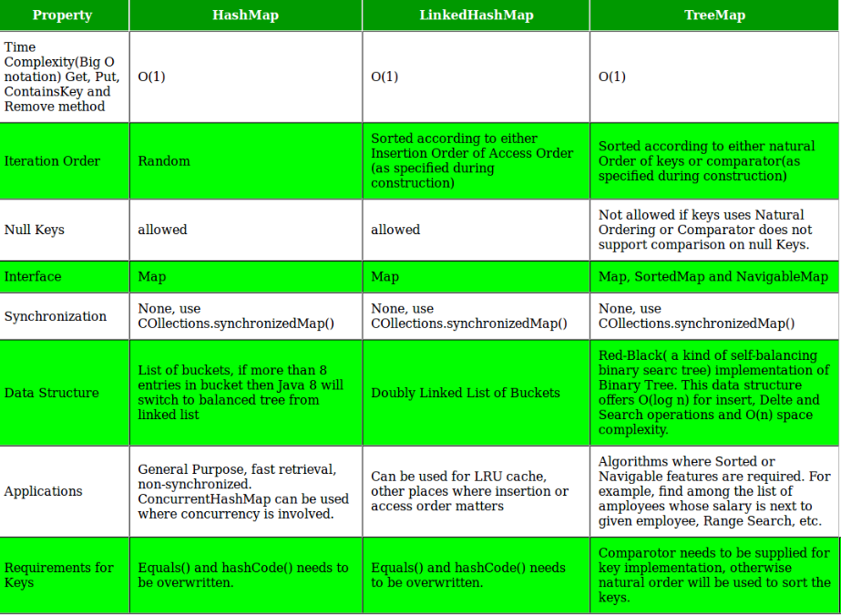

Slide 160
Java Comparable interface
Java Comparable interface is used to order the objects of the user-defined class. This interface is found in java.lang package and contains only one method named compareTo(Object). It provides a single sorting sequence only, i.e., you can sort the elements on the basis of single data member only. For example, it may be rollno, name, age or anything else.
compareTo(Object obj) method
It returns
positive integer, if the current object is greater than the specified object.
negative integer, if the current object is less than the specified object.
zero, if the current object is equal to the specified object.

Slide 161
public class ComparableExample {
public static void main(String[] args) {
Integer valA = Integer.valueOf(45);
Integer valB = Integer.valueOf(99);
int comparisonA = valA.compareTo(valB);
int comparisonB = valB.compareTo(valA);
System.out.println(comparisonA);
System.out.println(comparisonB);
}
}

Slide 162
Student.java
public class Student implements Comparable{
//data members
private String name;
private String rollNo;
private int age;
//no-argument constructor
public Student(){
}
//argument cnstructor
public Student(String name, String rollNo, int age){
this.name = name;
this.rollNo = rollNo;
this.age = age;
}
public String getName() {
return name;
}
public void setName(String name) {
this.name = name;
}
public String getRollNo() {
return rollNo;
}
public void setRollNo(String rollNo) {
this.rollNo = rollNo;
}
public int getAge() {
return age;
}
public void setAge(int age) {
this.age = age;
}
//Method for sorting logic
public int compareTo(Object obj){
Student student=(Student)obj;
return (this.name).compareTo(student.name);
}
}

Slide 163
Test.java
public class Test {
public static void main(String args[]){
ArrayList studentList = new ArrayList();
studentList.add(new Student("Sandy", "MCA/07/06", 28));
studentList.add(new Student("Roxy", "MCA/07/32", 28));
studentList.add(new Student("Sunil", "MCA/07/15", 27));
studentList.add(new Student("Munish", "MCA/07/04", 27));
Collections.sort(studentList);
Iterator iterator=studentList.iterator();
while(iterator.hasNext()){
Student student=(Student)iterator.next();
System.out.println("Name: " + student.getName()+
", " + "RollNo: "+student.getRollNo()+
", Age: "+student.getAge());
}
}
}

Slide 164
Comparator interface
Java Comparator interface is used to order the objects of a user-defined class.
This interface is found in java.util package and contains 2 methods compare(Object obj1,Object obj2) and equals(Object element).
It provides multiple sorting sequences, i.e., you can sort the elements on the basis of any data member, for example, rollno, name, age or anything else.

Slide 165
Sort the list of objects on the basis of a single field using the Comparable and Comparator interface
// Java Program to Demonstrate Working of
// Comparator Interface
// Importing required classes
import java.io.*;
import java.lang.*;
import java.util.*;
// Class 1
// A class to represent a Student
class Student {
// Attributes of a student
int rollno;
String name, address;
// Constructor
public Student(int rollno, String name, String address)
{
// This keyword refers to current instance itself
this.rollno = rollno;
this.name = name;
this.address = address;
}
// Method of Student class
// To print student details in main()
public String toString()
{
// Returning attributes of Student
return this.rollno + " " + this.name + " "
+ this.address;
}
}
// Class 2
// Helper class implementing Comparator interface
class Sortbyroll implements Comparator<Student> {
// Method
// Sorting in ascending order of roll number
public int compare(Student a, Student b)
{
return a.rollno - b.rollno;
}
}
// Class 3
// Helper class implementing Comparator interface
class Sortbyname implements Comparator<Student> {
// Method
// Sorting in ascending order of name
public int compare(Student a, Student b)
{
return a.name.compareTo(b.name);
}
}
// Class 4
// Main class
class Main {
// Main driver method
public static void main(String[] args)
{
// Creating an empty ArrayList of Student type
ArrayList<Student> ar = new ArrayList<Student>();
// Adding entries in above List
// using add() method
ar.add(new Student(111, "Mayank", "london"));
ar.add(new Student(131, "Anshul", "nyc"));
ar.add(new Student(121, "Solanki", "jaipur"));
ar.add(new Student(101, "Aggarwal", "Hongkong"));
// Display message on console for better readability
System.out.println("Unsorted");
// Iterating over entries to print them
for (int i = 0; i < ar.size(); i++)
System.out.println(ar.get(i));
// Sorting student entries by roll number
Collections.sort(ar, new Sortbyroll());
// Display message on console for better readability
System.out.println("\nSorted by rollno");
// Again iterating over entries to print them
for (int i = 0; i < ar.size(); i++)
System.out.println(ar.get(i));
// Sorting student entries by name
Collections.sort(ar, new Sortbyname());
// Display message on console for better readability
System.out.println("\nSorted by name");
// // Again iterating over entries to print them
for (int i = 0; i < ar.size(); i++)
System.out.println(ar.get(i));
}
}

Slide 166
Sort collection by more than one field
eg-we have a requirement to sort ArrayList objects in accordance with more than one field like firstly, sort according to the student name and secondly, sort according to student age

Slide 167
// Java Program to Demonstrate Working of
// Comparator Interface Via More than One Field
// Importing required classes
import java.util.ArrayList;
import java.util.Collections;
import java.util.Comparator;
import java.util.Iterator;
import java.util.List;
// Class 1
// Helper class representing a Student
class Student {
// Attributes of student
String Name;
int Age;
// Parameterized constructor
public Student(String Name, Integer Age)
{
// This keyword refers to current instance itself
this.Name = Name;
this.Age = Age;
}
// Getter setter methods
public String getName() { return Name; }
public void setName(String Name) { this.Name = Name; }
public Integer getAge() { return Age; }
public void setAge(Integer Age) { this.Age = Age; }
// Method
// Overriding toString() method
@Override public String toString()
{
return "Customer{"
+ "Name=" + Name + ", Age=" + Age + '}';
}
}
// Class 2
// Helper class implementing Comparator interface
class CustomerSortingComparator
implements Comparator<Student> {
// Method 1
// To compare customers
@Override
public int compare(Student customer1, Student customer2)
{
// Comparing customers
int NameCompare = customer1.getName().compareTo(
customer2.getName());
int AgeCompare = customer1.getAge().compareTo(
customer2.getAge());
// 2nd level comparison
return (NameCompare == 0) ? AgeCompare
: NameCompare;
}
}
// Method 2
// Main driver method
class Main {
public static void main(String[] args)
{
// Create an empty ArrayList
// to store Student
List<Student> al = new ArrayList<>();
// Create customer objects
// using constructor initialization
Student obj1 = new Student("Ajay", 27);
Student obj2 = new Student("Sneha", 23);
Student obj3 = new Student("Simran", 37);
Student obj4 = new Student("Ajay", 22);
Student obj5 = new Student("Ajay", 29);
Student obj6 = new Student("Sneha", 22);
// Adding customer objects to ArrayList
// using add() method
al.add(obj1);
al.add(obj2);
al.add(obj3);
al.add(obj4);
al.add(obj5);
al.add(obj6);
// Iterating using Iterator
// before Sorting ArrayList
Iterator<Student> custIterator = al.iterator();
// Display message
System.out.println("Before Sorting:\n");
// Holds true till there is single element
// remaining in List
while (custIterator.hasNext()) {
// Iterating using next() method
System.out.println(custIterator.next());
}
// Sorting using sort method of Collections class
Collections.sort(al,
new CustomerSortingComparator());
// Display message only
System.out.println("\n\nAfter Sorting:\n");
// Iterating using enhanced for-loop
// after Sorting ArrayList
for (Student customer : al) {
System.out.println(customer);
}
}
}

Slide 168
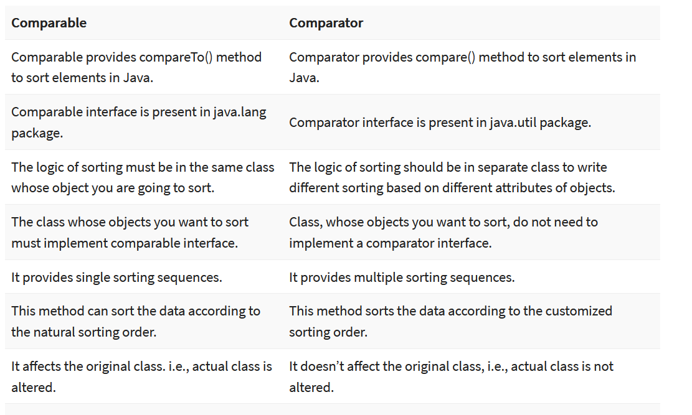
Difference between Comparable and Comparator

